Slide 1
Machine Learning Project on Avocado Dataset Presented by: Kasturi Sahu

Slide 2
Agenda
Description of Data
Exploratory Data Analysis (EDA)
Data Set Machine Learning
Model Evaluation Observation
Conclusion

Slide 3

Avocado Dataset
I am Kasturi Sahu

Slide 4
Description of Data
Avocado is a fruit consumed by people heavily in the United States. This data was downloaded from the Hass Avocado Board website in May of 2018 & compiled into a single CSV. Starting in 2013, the table below reflects an expanded, multi-outlet retail data set. Multi-outlet reporting includes an aggregation of the following channels: grocery, mass, club, drug, dollar and military. The Average Price (of avocados) in the table reflects as per unit (per avocado) cost, even when multiple units (avocados) are sold in bags. The Product Lookup codes (PLU’s) in the table are only for Hass avocados. Other varieties of avocados (e.g. green skins) are not included in this table.
Our task is to make a mode that can consider the data provided and predict the Average Price.

Slide 5
Columns in the Dataset: Our task is to predict the average price which is continuous in nature.
ID | Feature | Description
01 | Date | The date of the observation
02 | AveragePrice | The average price of a single Avocado
03 | type | Conventional or Organic
04 | year | The year
05 | Region | The city or region of the observation
06 | Total Volume | Total number of Avocados sold
07 | 4046 | Total number of avocados with PLU 4046 sold
08 | 4225 | Total number of avocados with PLU 4225 sold
09 | 4770 | Total number of avocados with PLU 4770 sold

Slide 6
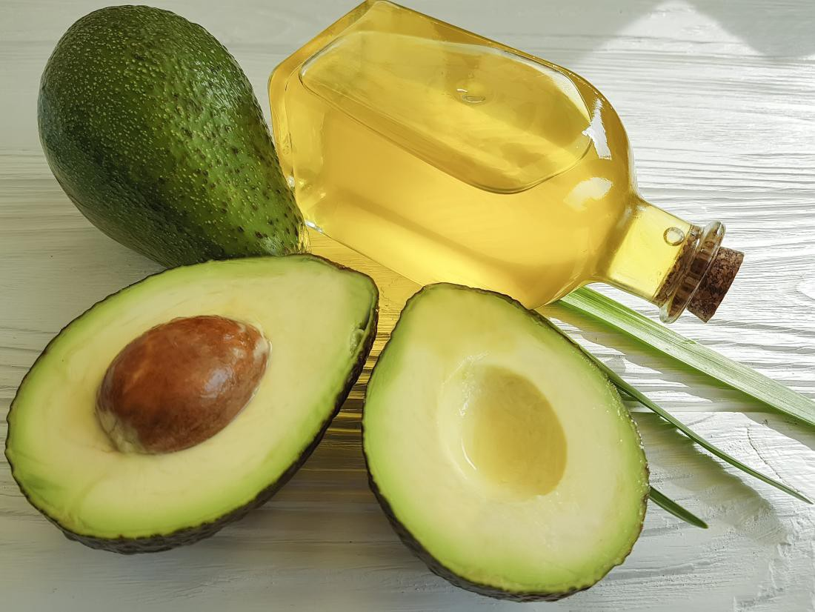

Slide 7
There are 18249 rows and 14 columns
There are 2 Types of Avocados
There are no missing values
There are 9 Float, 2 Integer and 3 Object columns

Slide 8

Exploratory Data Analysis (EDA)

Slide 9
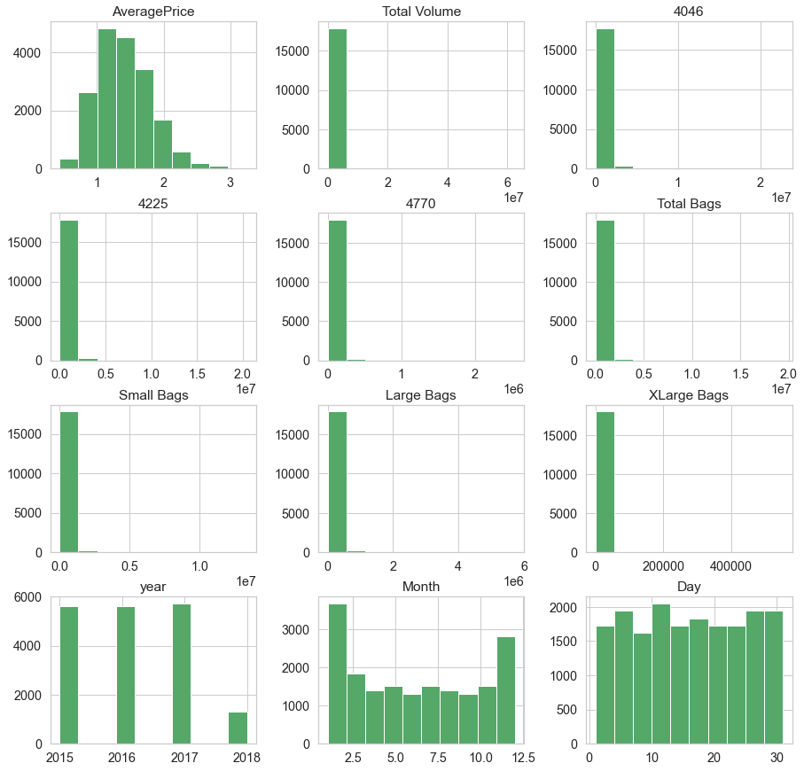
All Columns Histogram
Average price column is normally distributed over the histogram

Slide 10
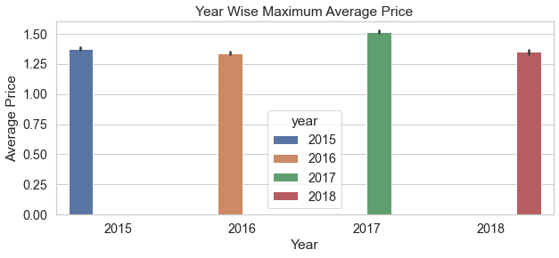
Which year has Maximum Average Price
The Average Price was Maximum in 2017

Slide 11
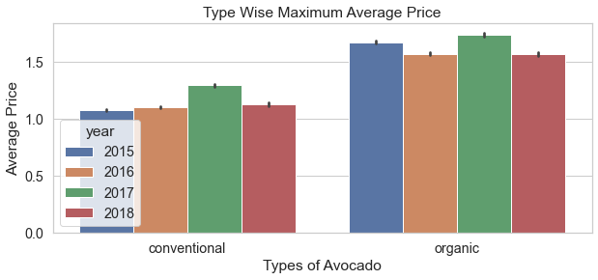
Year wise distribution of Average Price
We can see "Organic Avocado" has maximum Average Price in every year

Slide 12
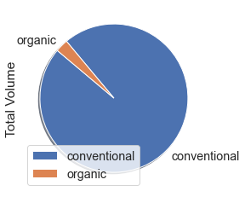
Maximum Volume of Avocados
So it looks like Conventional is in more demand

Slide 13
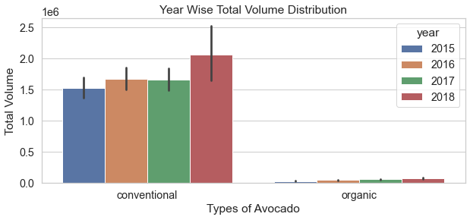
Year wise Distribution of Volume
Conventional Avocado were sold more in each year

Slide 14
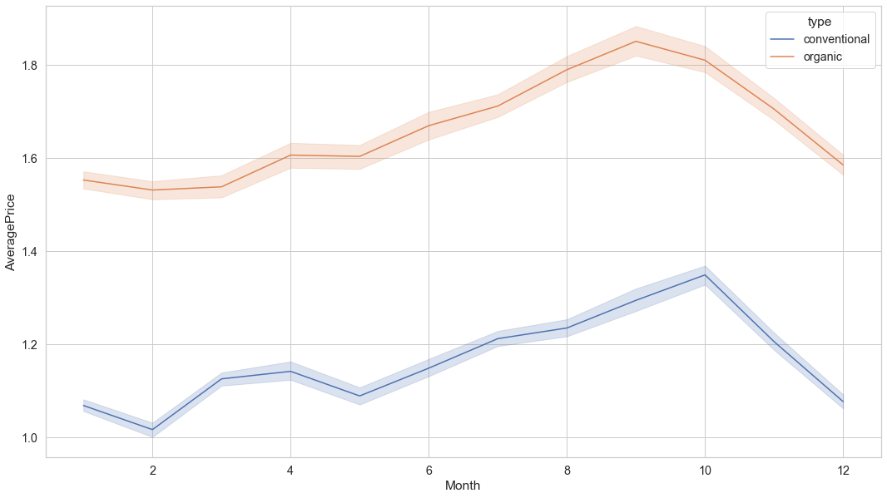
Distribution of Average Price over Months
There was a hike between months 8 – 10 for both Conventional and Organic type of Avocados prices

Slide 15
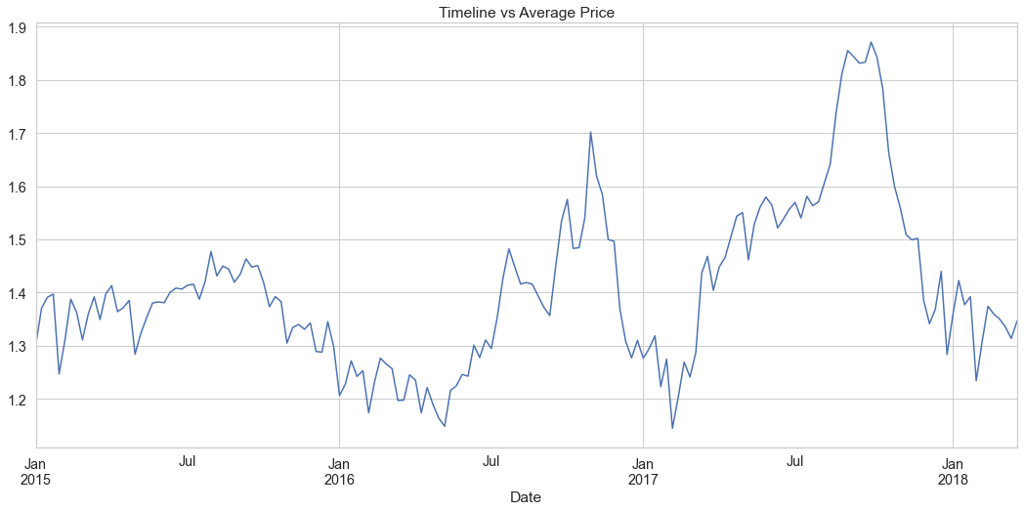
Price Distribution over the Date Column
This shows there was a huge hike in prices after July 2016 and before Jan 2018

Slide 16
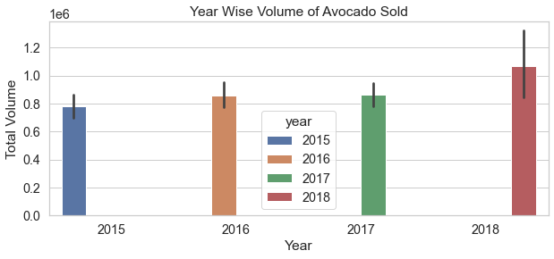
Year Wise Volume of Avocado Sold
The sell was maximum in 2018

Slide 17
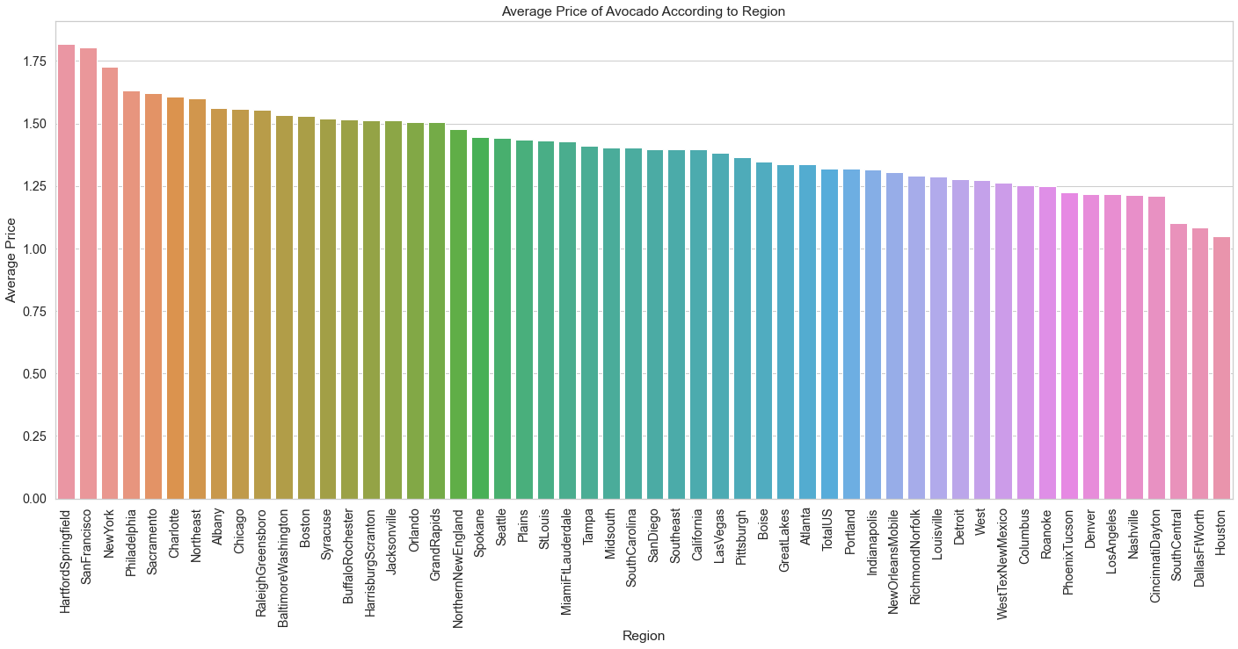
Which Region has Maximum Average Price
The Regions are listed alphabetically
Hartford Springfield has the maximum Average Price
Houston has the minimum Average Price

Slide 18
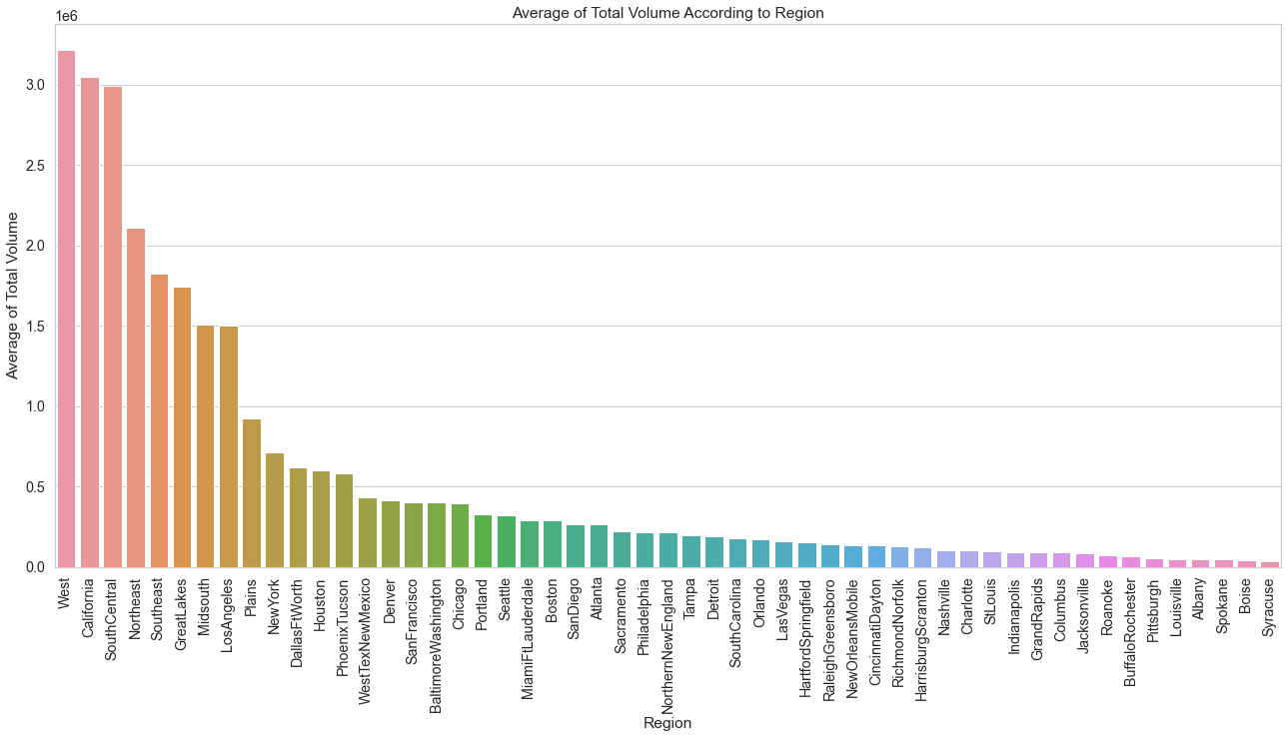
Which Region has Highest Consumption
West has the maximum Consumption
Syracuse has the minimum Consumption

Slide 19
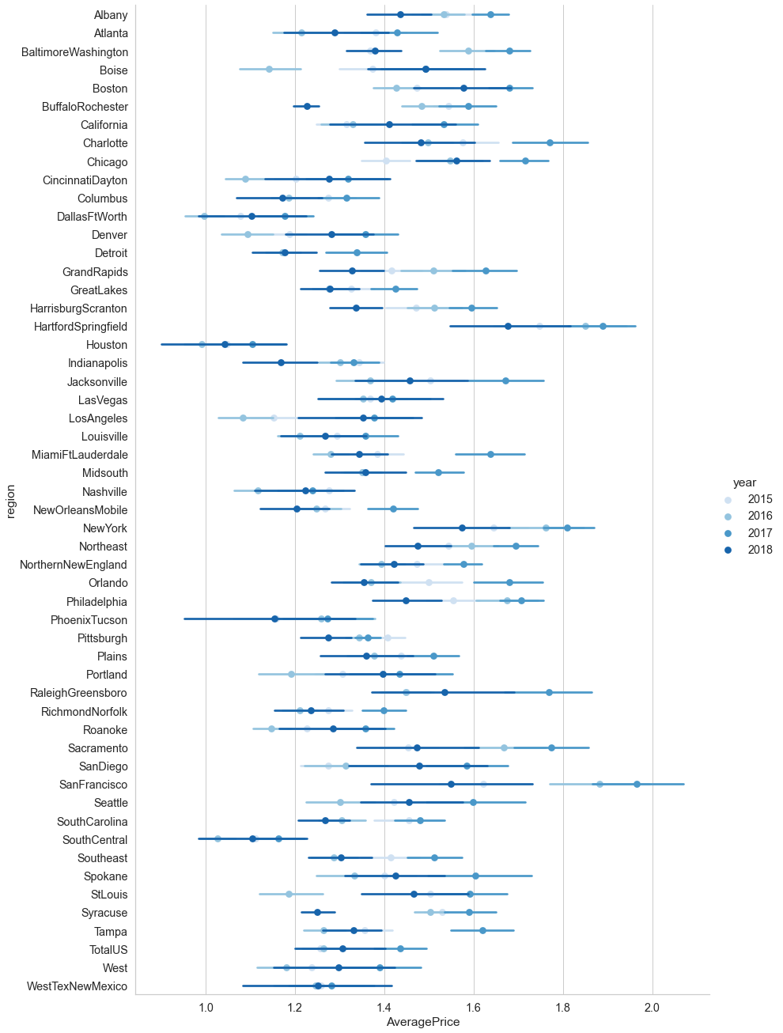
Average Price Year and Region Wise
There was a huge increase in Avocado prices in Year 2017 in SanFranciso region

Slide 20
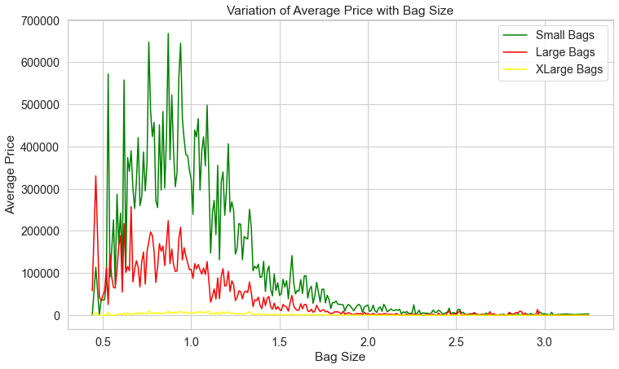
Variation of Average Price with Bag Size
Small Bags have maximum Average Price than XLarge Bags

Slide 21
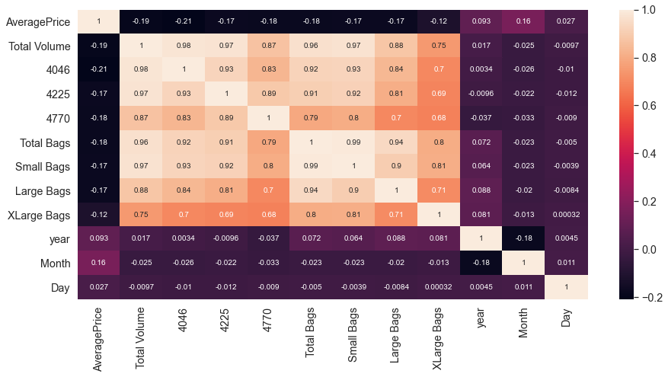
Correlation
Total Bags is highly co-related to Small Bags.
The correlation between the Average Price and 4046 is very low.

Slide 22
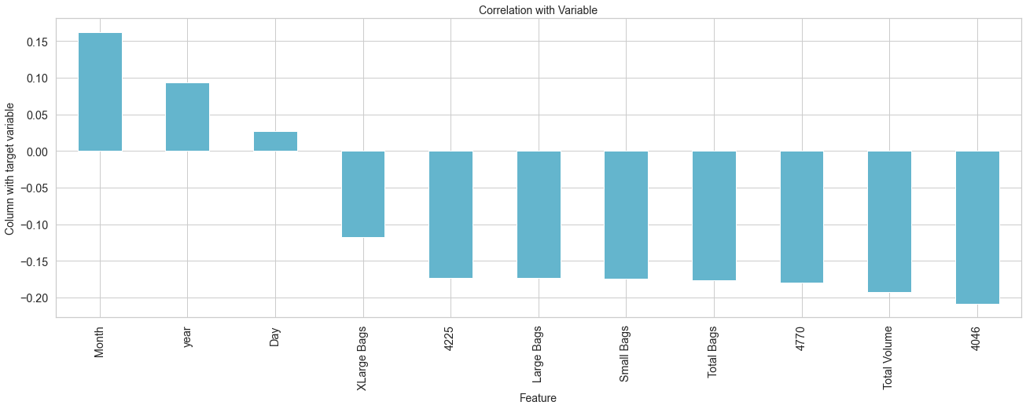
Correlation with Variable
It very clear that "Day" is close to 0 co-relation
All the Features have positive or a negative co-relation

Slide 23
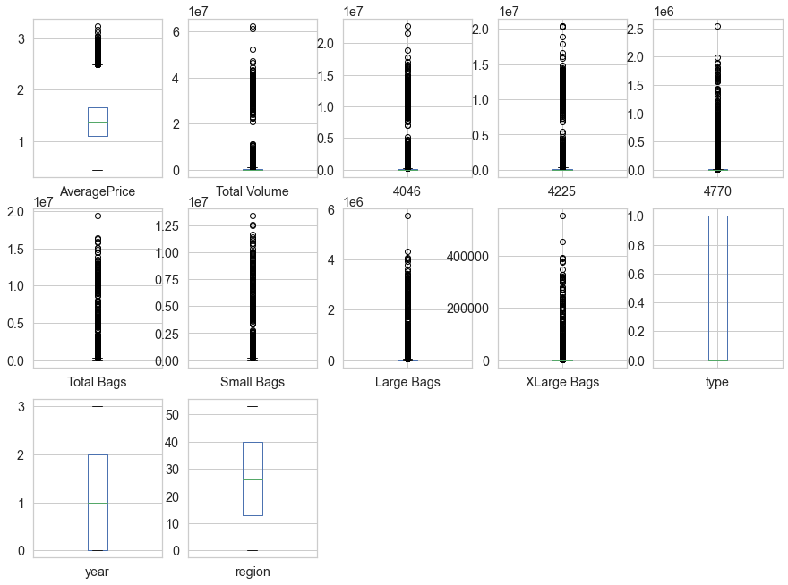
Handling Outlier
From this image we can see that there are number of black dots in most of the column which are referring to the outliers, so it means most of the data are outside the distribution.
The second step is to remove the outliers, there are different way to remove the outliers that are find the IQR, Zscore values

Slide 24
Z Score
We find the zscore value and then we have decided to make one threshold value as 3 which is standard of industry recommend value
We removed all the outliers which zscore value is greater than 3
After removing the outlier finally there are 17651 rows and 14 columns presents in the data set.
Skewness
We first calculated the skew value and see some of the column skew value are far from zero
The best skew value for normally distribution is very close to zero, so we used “log1p” method to make the skew value near to zero
Making the skewness value near to zero will help to get better score
Label Encoding
We have converted Region, Year and Type to numerical form
Dropping Date, Month and Day Column
We have removed Date, Month and Day column

Slide 25
Data Set Machine Learning

Slide 26
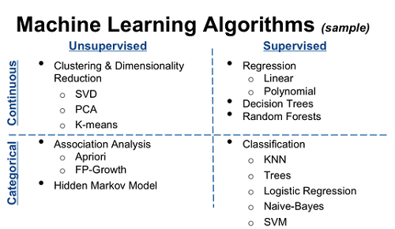
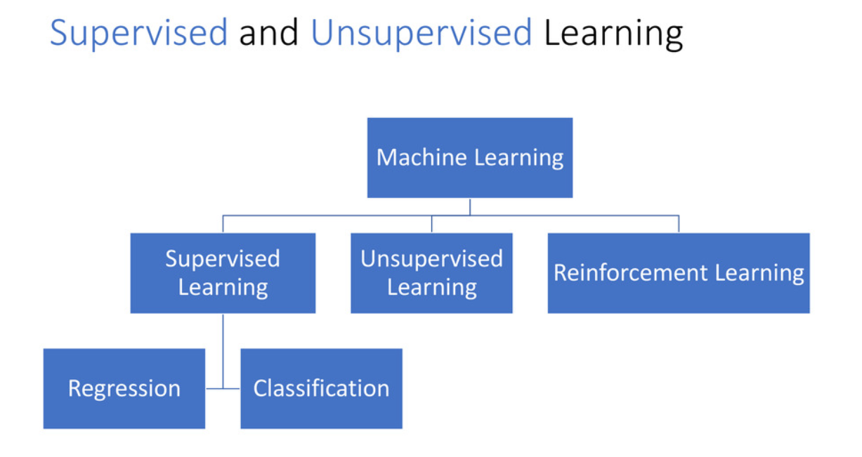
Models used to Evaluate
Linear Regression
Random Forest
Gradient Boosting
Decision Tree
K-Nearest Neighbour

Slide 27
Train & Test Data
Features & Target
features = ['Total Volume', '4046', '4225', '4770', 'Total Bags', 'Small Bags', 'Large Bags', 'XLarge Bags', ‘type’, 'year', 'region']
target = ['AveragePrice’]
Test –Set 20%: Shape of Train & Test Set
Train cases as below
x_train shape : (14120, 11)
y_train shape: (14120, 1)
***************************
Test cases as below
x_test shape: (3531, 11)
y_test shape: (3531, 1)

Slide 28
Difference of Cross Validation from R2 & RMSE
Name | Error | R2 | MAE | MSE | RMSE | Cross Validation | R2 and CV Difference | RMSE and CV Difference
Linear Regression | 0.52 | 0.5 | 0.2 | 0.1 | 0.26 | 0.52 | 0.02 | 0.53
Lasso | 0.29 | 0.3 | 0.3 | 0.1 | 0.32 | 0.3 | 0.01 | 0.64
Ridge | 0.52 | 0.5 | 0.2 | 0.1 | 0.26 | 0.52 | 0.02 | 0.53
Gradient boosting | 0.69 | 0.7 | 0.2 | 0.1 | 0.22 | 0.68 | 0 | 0.44
Decision Tree | 1 | 0.7 | 0.1 | 0.1 | 0.22 | 0.7 | -0.02 | 0.43
Random Forest | 0.98 | 0.9 | 0.1 | 0 | 0.15 | 0.85 | 0 | 0.3
Kneighbor | 0.82 | 0.7 | 0.2 | 0 | 0.21 | 0.73 | -0.02 | 0.4
We have used 7 models and 5 Evaluation Techniques for Model Building
We have evaluated difference between R2 and Cross Validation and RMSE and Cross Validation. It is low in case of Random Forest Model
The best way to select a model is to have high R2 and low RMSE and Random Forest have the same
We will use Random Forest model for our model tuning

Slide 29
Feature Engineering
Name | Error | R2 | MAE | MSE | RMSE | Cross Validation | R2 and CV Difference | RMSE and CV Difference
Linear Regression | 0.41 | 0.4 | 0.2 | 0.1 | 0.29 | 0.41 | 0 | 0.59
Lasso | 0.13 | 0.1 | 0.3 | 0.1 | 0.36 | 0.13 | 0 | 0.72
Ridge | 0.41 | 0.4 | 0.2 | 0.1 | 0.29 | 0.41 | 0 | 0.59
Gradient boosting | 0.69 | 0.7 | 0.2 | 0.1 | 0.22 | 0.68 | 0.01 | 0.44
Decision Tree | 1 | 0.7 | 0.2 | 0.1 | 0.22 | 0.69 | -0.02 | 0.43
Random Forest | 0.98 | 0.9 | 0.1 | 0 | 0.15 | 0.85 | 0 | 0.3
Kneighbor | 0.77 | 0.7 | 0.2 | 0.1 | 0.22 | 0.67 | 0.01 | 0.44
After dropping one column, our score for Random forest has not been improved
So for the same reasons (High R2 and low RMSE) we are choosing Random Forest again for our Hyper Parameter tuning

Slide 30
Hyper Parameter Tuning
Models | Score
Random Forest | 0.8498889055975501
K Neighbor Regressor | 0.6669705418500598
Gradient Boosting Regressor | 0.6828757809963262
Random Forest has the highest value which is 0.84

Slide 31
Conclusion
Model Building Was done in 2 ways after finding the Best Random state
We have used 7 models and 5 Evaluation Techniques. Also, found the difference between R2 and Cross Validation, RMSE and Cross Validation
We have used Feature Engineering dropping one column. Still, our score for Random forest has not been improved
Hyper Parameter Tuning was done on 3 models
As per the evaluation with (80:20) training and testing data, Random Forest is the best model

Slide 32
Thanks!
Any questions?
You can find me at
kasturi.dash@gmail.com

